Slide 1
Query by Humming Searching Oct 28th
Jiarui Xu(Jerry), Alexander Lerch

Slide 2
This week
Use MIDI data to test the system
Find algorithm about subsequence search
Thinking of modification

Slide 3

Evaluate query by humming system
50 wave files with 50 midi ground truth file
Edit distance(just first10 seconds fragment), accuracy:12%
DTW (just, 10 seconds fragment), accuracy:11.5%
Edit distance(40 seconds, hop very note), accuracy: about 60%(only see the first 10 results)

Slide 4


Accuracy for midi testing
Accuracy:100%
50 midi files searching in 50 midi files
Time length=15seconds
Method: DTW and ED distance
So the accuracy problems in searching is not caused by similar contour in songs.

Slide 5
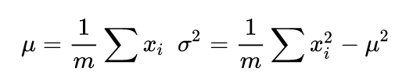
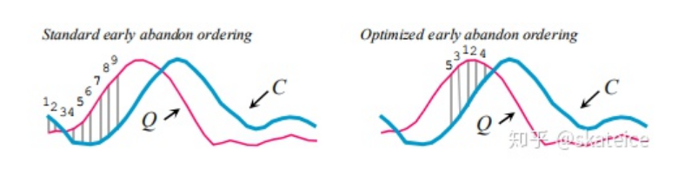
Way to do subsequence search: Optimizing DTW
Complexity of DTW is O(mn), m and n is the length of the input sequence and ground truth sequence.
Optimizing:
Early abandoning Z-Normalization
Early abandoning: When the score is better than best-so-far, stop calculation to save time.
Low-Bounding

Slide 6
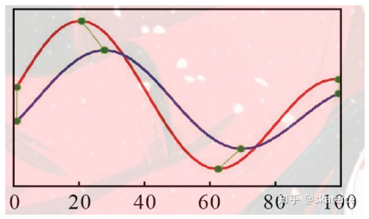
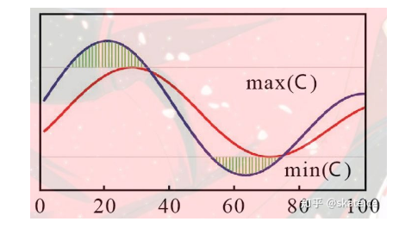
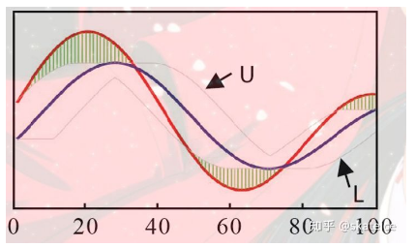
For low-Bounding
LB_Kim
LB_Yi
LB_Keogh

Slide 7
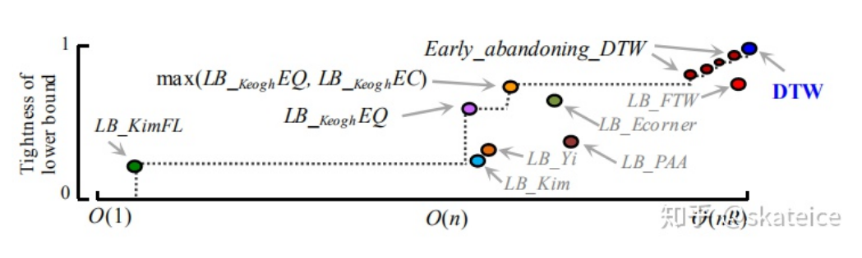
Complexity

Slide 8
Modifying
For fast searching: vectorize
For accuracy: long audio and hope by every note to search

Slide 9
Thank you!

